Slide 1
Numerical Integration: Newton-Cotes
AMSC/CMSC 460
Dr. Christopher Moakler

Slide 2
What is an Integral?
This also isn’t rhetorical.

Slide 3
Why do we use Integrals?
Many physical formulae call for integrals.
Work
Distance, velocity, acceleration.
Volumes of objects.
Average value of a function.
Probability.

Slide 4
What’s harder? Taking a Derivative or an Integral?

Slide 5
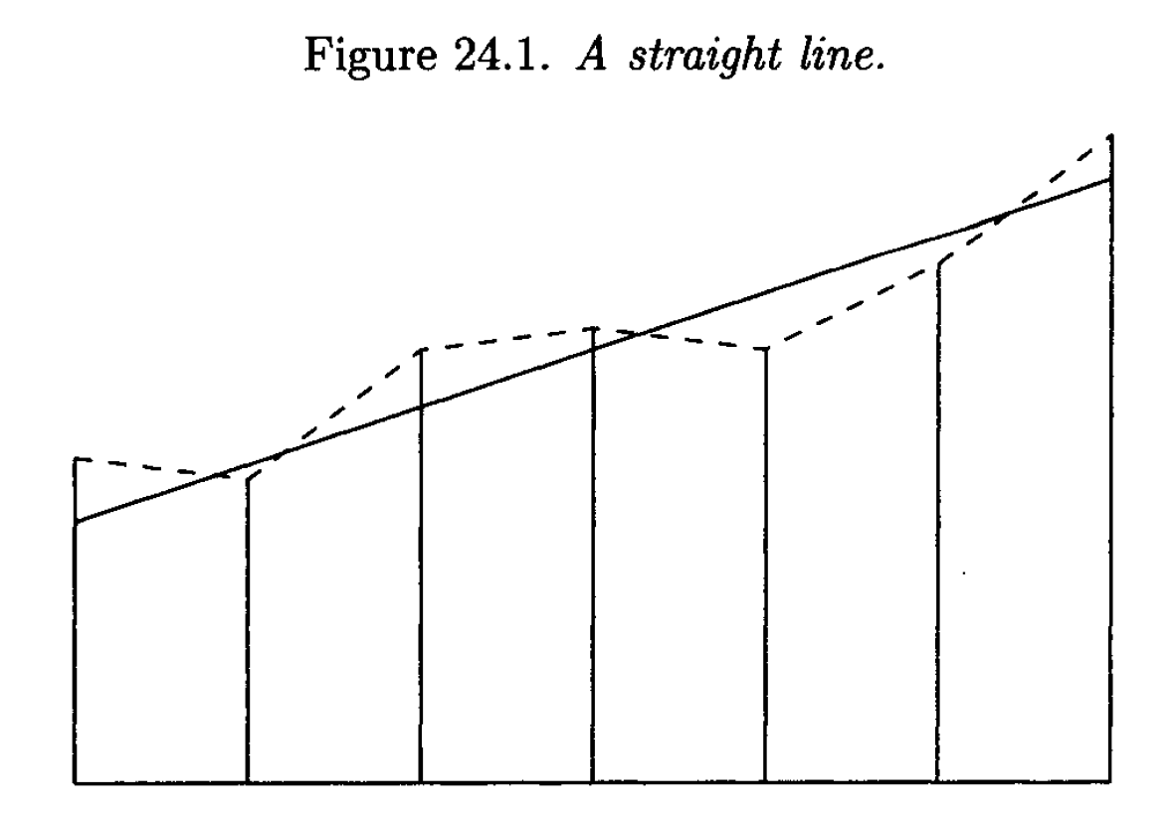
Differentiation vs Integration
Hoffman
Notes:
The exact derivative is constant along the entire range.
The approximate integral is relatively accurate with some intervals over approximating but others under approximating.
The derivative however, is all over the place!

Slide 6
Numerical Differentiation vs Numerical Integration
Analytic Integration is, in general, much harder to do than analytic differentiation.
One of the issues here is that the integration of one class of functions is not necessarily closed.
For example, what is the integral of $f\left(x\right)=\frac{1}{x}$?
However, to compute a definite integral, we only need information about the function at a select few points.
Sure, we won’t get an exact answer, but we can get a decent approximation!

Slide 7
How can we approximate an integral?
First, we need to know what information is available to us.
If we have a closed form equation for the function, we can ideally perform the integration explicitly.
We might also be able to use a symbolic integration application to do this for us.
However, we often only have access to a small subset of data points.
These might be tabulated data or the results of long costly computer simulations.
The main approach is to approximate the function with a polynomial and integrate that function.

Slide 8
Polynomial Interpolation for Numerical Integration
The polynomial interpolation approach can be broken up into two classes,
Approximating the entire function with a polynomial and integrating the polynomial.
Breaking the function into smaller subintervals and approximating each interval with a polynomial.

Slide 9
Direct Fit Polynomial
If we have a collection of data points, we can interpolate a polynomial between all of the data points.
That is, we directly fit a polynomial.
We then integrate that function.
In equation form we have,
$$∫f\left(x\right)dx≅∫P_{n}\left(x\right)dx$$
This has some major drawbacks, many of which we have already discussed.

Slide 10
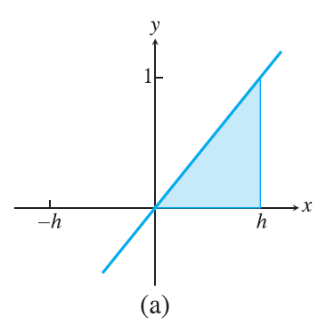
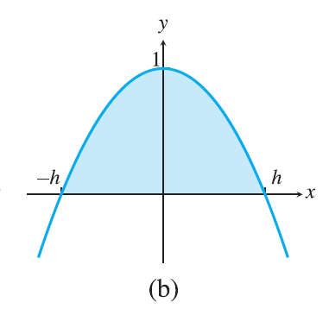
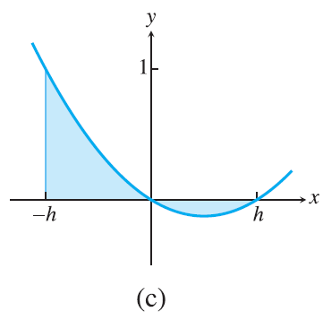
Direct Fit Polynomial Examples
In a), we have two known points (0,0) and (h,1).
We can interpolate a degree 1 polynomial and integrate it.
$$\int_{0}^{h}{P_{1}(x)}dx=\int_{0}^{h}{\frac{x}{h}}dx=\frac{h}{2}$$
In b), we have three known points (-h,0), (0,1), and (h,0).
We can interpolate a degree two polynomial and integrate.
$$\int_{−h}^{h}{P_{2}(x)}dx=\left(x −\frac{x^{3}}{3h^{2}}\right){{\left.​\right|}^{x=h}}_{x=−h} =\frac{4}{3}h$$
In c), we have three known points (-h,1), (0,0), and (h,0).
We can interpolate a degree two polynomial and integrate.
$$\int_{−h}^{h}{P_{2}(x)}=\frac{1}{3}h$$
Sauer

Slide 11
Issues with direct fit polynomial interpolation
Directly fitting polynomials that we then integrate has several issues.
First, it can be very costly to interpolate a polynomial if there are many data points.
We have to use one of the previously discussed interpolation methods.
Secondly, we run into all the issues we saw previously with fitting higher order polynomials to data points.
Runge Phenomenon.
The polynomial might not actually approximate the function well.
We can overcome this to some “degree” by using least squares to fit a lower degree polynomial.

Slide 12
Newton-Cotes Formulae
Let $f\left(x\right)$ be a function that is twice continuously differentiable defined on an interval $\left[a,b\right]$.
We can use the Lagrange Interpolation method to find a degree one polynomial between the points $(a,f\left(a\right))$ and $(b,f\left(b\right))$.
The interpolating polynomial is,
$$f\left(x\right)≈f\left(a\right)\frac{x−b}{a−b}+f\left(b\right)\frac{x−a}{b−a}$$
We can include an error term as well,
$$f\left(x\right)=f\left(a\right)\frac{x−b}{a−b}+f\left(b\right)\frac{x−a}{b−a}+\frac{\left(x−a\right)\left(x−b\right)}{2!}f^{′′}\left(c\right)=P_{1}\left(x\right)+E(x)$$
We want the integral of $f(x)$ so,
$$\int_{a}^{b}{f\left(x\right)dx}=\int_{a}^{b}{P\left(x\right)dx}+\int_{a}^{b}{E\left(x\right)dx}$$

Slide 13
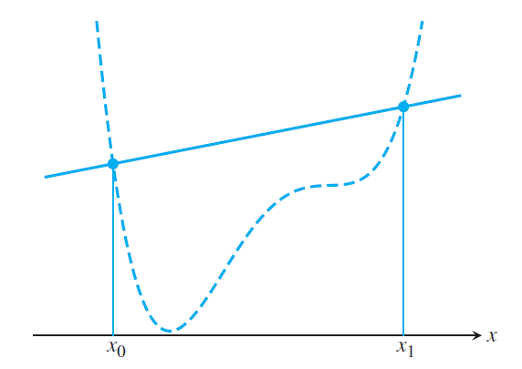
Trapezoid Rule
Evaluating the integral gives,
$$\int_{a}^{b}{f\left(x\right)dx}≅\int_{a}^{b}{P\left(x\right)dx}=f\left(a\right)\frac{h}{2}+f\left(b\right)\frac{h}{2}$$
where $h=b−a$.
Simplifying a bit yields,
$$\int_{a}^{b}{f\left(x\right)dx}≅h\frac{f\left(a\right)+f\left(b\right)}{2}$$
This is the area of a trapezoid which is where the rule gets its name.
In the example, you can see this overestimates the area.
It’s also possible to underestimate the area.
Sauer

Slide 14
Trapezoid Rule Error Term
If we return to the Error term and integrate it,
$$\int_{a}^{b}{E\left(x\right)}dx=\int_{a}^{b}{\frac{\left(x−a\right)\left(x−b\right)}{2!}f^{′′}\left(c\right)}dx$$
$$=\frac{f^{′′}\left(c\right)}{2}\int_{a}^{b}{(x−a)(x−b)}dx$$
$$\int_{a}^{b}{E\left(x\right)}dx=−\frac{h^{3}}{12}f^{′′}\left(c\right)$$

Slide 15
Trapezoid Rule Formula
Bringing it all together we have the trapezoid rule for integrating a function over an interval.
$$\int_{a}^{b}{f\left(x\right)dx}=h\frac{f\left(a\right)+f\left(b\right)}{2}−\frac{h^{3}}{12}f^{′′}\left(c\right)$$
where $h=b−a$ and $c ε \left[a,b\right]$

Slide 16
Rectangle Rule
We could instead interpolate degree 0 polynomial, a straight line.
This leads to the “rectangle rule”
This of a left Riemann Sum.

Slide 17
Simpson’s 1/3 Rule
We can instead interpolate a degree 2 polynomial and integrate that.
$$f\left(x\right)=f\left(a\right)\frac{(x−b)(x−c)}{(a−b)(a−c)}+f\left(b\right)\frac{(x−a)(x−c)}{(b−a)(b−c)}+f\left(c\right)\frac{(x−a)(x−b)}{(c−a)(c−b)}+\frac{(x−a)(x−b)(x−c)}{3!}f^{′′′}\left(c\right)=P\left(x\right)+E(x)$$
We can integrate this and get,
$$\int_{a}^{c}{f(x)}dx≅f\left(a\right)\frac{h}{3}+f\left(b\right)\frac{4}{3}h+f\left(c\right)\frac{h}{3}$$
where $h=b−a=c−b$

Slide 18
Simpson’s 1/3 Rule Error Term
The error term for Simpson’s 1/3 rule is,
$$\int_{a}^{c}{E\left(x\right)}dx=−\frac{h^{5}}{90}f′′′′(c)$$
where c is between a and c.
You can see this error is of a much higher order than the trapezoid rule error!

Slide 19
Simpson’s 1/3 Rule Equation
Bringing it all together now,
$$\int_{a}^{c}{f(x)}dx≅\frac{h}{3}\left( f\left(a\right)+4f\left(b\right)+f\left(c\right)\right)−\frac{h^{5}}{90}f′′′′(c)$$
where $h=b−a=c−b$ and $c ε [a, c]$.

Slide 20
Trapezoid Rule Example
Approximate $\int_{1}^{2}{ln⁡(x)}dx$ using the Trapezoid Rule.
The Trapezoid Rule states,
$$\int_{1}^{2}{ln⁡(x)}dx≅\frac{h}{2}\left(f\left(a\right)+f\left(b\right)\right)=\frac{1}{2} \left(\ln\left(1\right)+\ln\left(2\right)\right)≈0.3466$$
We can also put bounds on the error using $\frac{−h^{3}}{12}f^{′′}\left(c\right)$.
The error is bounded by
$$\frac{−1^{3}}{12}\left(−\frac{1}{x^{2}}\right)≤\frac{1}{12}≈0.0833…$$
The error in this case is $≈0.039694$.

Slide 21
Simpson’s 1/3 Rule Example
Approximate $\int_{1}^{2}{ln⁡(x)}dx$ using Simpson’s 1/3 Rule.
Simpson’s 1/3 rule is $\int_{a}^{c}{f(x)}dx≅\frac{h}{3}\left( f\left(a\right)+4f\left(b\right)+f\left(c\right)\right)$
Plugging in we get,
$$\int_{1}^{2}{ln(x)}dx≅\frac{0.5}{3}\left( ln\left(1\right)+4ln\left(\frac{3}{2}\right)+ln\left(2\right)\right)≈0.3858$$
The error is bounded by
$−\frac{h^{5}}{90}f^{′′′′}\left(c\right)={\left(\frac{1}{2}\right)}^{5}\frac{1}{90} \left(−\frac{6}{c^{4}}\right)≤\frac{1}{480}$
The error in this case is $≈0.000494$.

Slide 22
Degree of Precision
When we discussed numerical differentiation, we spoke of the order of the approximation.
This characterized how accurate our approximation was and how it scaled with the step size.
When discussing numerical integration, we often speak about the degree of precision.
The degree of precision of a numerical integration method is the largest integer such that a polynomial of that degree is exactly integrated by the method.
The Trapezoid Rule has a degree of precision of 1.
This should be pretty obvious since a trapezoid will exactly integrate a straight line.

Slide 23
Degree of Precision of Simpson’s 1/3 Rule
The degree of precision of Simpson’s 1/3 rule is surprisingly 3.
You can see this in the error term which depends on the fourth derivative of the function.
Thus, the degree of precision must be 3.
This is still difficult to see geometrically.
However, a parabola that intersects a cubic curve at three equally spaced points has the same integral as the cubic curve.
Weird, right?

Slide 24
Simpson’s 3/8 Rule
We can also fit a degree 3 polynomial to 4 equally spaced points.
I won’t write out the entire interpolating polynomial and I’ll just give the final result.
Simpson’s 3/8 Rule states
$$\int_{a}^{d}{f(x)}≅\frac{3}{8}h\left(f\left(a\right)+3f\left(b\right)+3f\left(c\right)+f\left(d\right)\right) −\frac{3}{80}h^{5}f^{′′′′}\left(c\right)$$
where $h=b−a=c−b=d−c$ and $c ε [a,d]$

Slide 25
Higher Order Newton-Cotes Formulae
We can get even higher order interpolation formulae if we wish.
They take the general form
$$\int_{a}^{b}{f(x)}dx=nβh\left(α_{0}f_{0}+α_{1}f_{1}+ …\right)+Error$$
Hoffman

Slide 26
Integrals over an interval
We have looked at integrals of functions over an interval $[a,b]$.
Our error terms scale with $h^{3}$ or $h^{5}$ for the Trapezoid Rule and Simpson’s Rules.
Those errors will be very large if the intervals we integrate over are large.
How can we overcome this problem?

Slide 27
Composite Newton-Cotes Formulae
The way we will overcome this problem is by breaking a larger interval into many different “sub-intervals”.
We apply the various Newton-Cotes methods to each subinterval and sum the results since,
$$\int_{a}^{b}{f(x)}dx= \int_{x_{0}=a}^{x_{1}}{f\left(x\right)}dx+\int_{x_{1}}^{x_{2}}{f\left(x\right)}dx+…+\int_{x_{n−1}}^{x_{n}=b}{f\left(x\right)}dx$$
This is known as composite numerical integration.

Slide 28
Composite Trapezoid Rule
We will break the interval up into $n$ equally spaced subintervals,
$$a=x_{0}<x_{1}<x_{2}<…<x_{n−1}<x_{n}=b$$
When we apply this method to the Trapezoid Rule, we obtain
$$\int_{a}^{b}{f(x)}dx=\frac{h}{2}\left(f\left(a\right)+f\left(b\right)+2\sum_{i=1}^{n−1}{f\left(x_{i}\right)}\right)−\frac{\left(b−a\right)h^{2}}{12}f′′(c)$$
where $h=\frac{b−a}{n}$ and $c ε [a,b]$

Slide 29
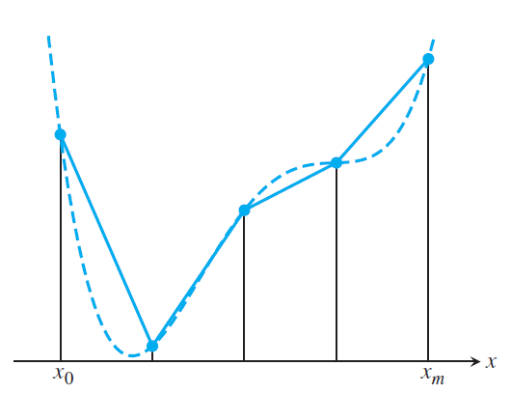
Composite Trapezoid Rule Example
Sauer

Slide 30
Composite Simpson's Rule
With an evenly spaced interval,
$$a=x_{0}<x_{1}<x_{2}<…<x_{2n−1}<x_{2n}=b$$
Similarly, we can get a composite Simpson’s Rule,
$$\int_{a}^{b}{f\left(x\right)}dx=\frac{h}{3}\left(f\left(a\right)+f\left(b\right)+4\sum_{i=1}^{n}{f(x_{2i−1})}+2\sum_{i=1}^{n−1}{f(x_{2i})}\right) −\frac{\left(b−a\right)h^{4}}{180}f^{′′′′}\left(c\right)$$
where $h=\frac{b−a}{n}$ and $c ε [a,b]$
Why the $2n$?

Slide 31
Composite Simpson’s Rule Example
Sauer

